Slide 1
HEALTH CARE CONNECT CLINIC
....a fictional health care provider
Fatimah Odumuyiwa
Data Science Intern, AnalystLab Africa

Slide 2
MISSION STATEMENT
HealthConnect Clinic is a fictional healthcare provider seeking to:
• Reduce missed appointments.
• Improve patient appointment attendance.
• Make better use of available appointment slots.
• Provide more effective administrative support to patients.

Slide 3
MY PROJECT JOURNEY – DATA SCIENCE TRACK
Week 4, understood the problem and planned the approach
Week 5, built a baseline Logistic Regression model
Week 6, tested Random Forest, began cross track work with Data Analytics
Week 7, tested Gradient Boosting, caught a false lead through cross validation, resolved a no show rate discrepancy.
Week 8, locked in the final model, completed integration and presentation

Slide 4
THREE MODELS: ONE FINAL CHOICE
Logistic Regression, my baseline, simple and reliable
Random Forest, tuned to reduce overfitting, strong but not my final choice
Gradient Boosting, tested as the leading challenger, ultimately tied with the baseline once properly evaluated
My final pick, Logistic Regression, for its reliability and simplicity

Slide 5
PREDICTION NOT JUST DESCRIPTION
HealthConnect didn't just need to know what happened with missed appointments, it needed to know who is likely to miss their next one. That is a prediction problem, so I chose a classification model, not a dashboard alone.

Slide 6
FALSE LEAD
Gradient Boosting first looked stronger on recall, 0.64 against the baseline's 0.62
Five fold cross validation showed the two models were actually statistically tied
I withdrew the apparent win once I tested it properly
This became my reason for choosing reliability over a result that didn't hold up

Slide 7
KEY METRICS
0.80
RECALL
0.58
My final model performance
Logistic Regression at 0.4 decision threshold
PRECISION
0.004
TRAIN TEST GAP

Slide 8
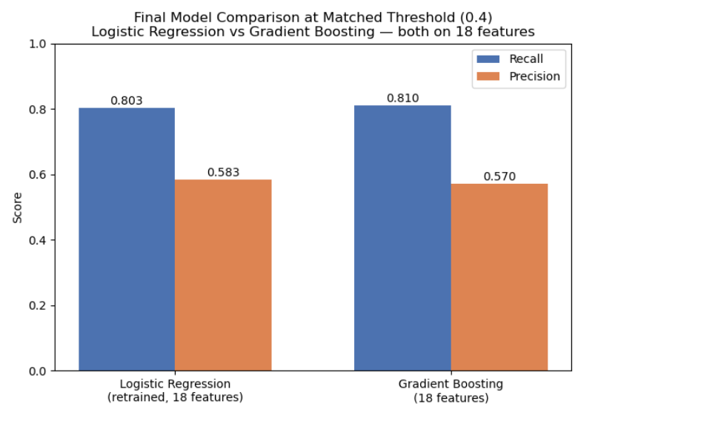

Slide 9
MODEL TO RECOMMENDATION
A precision of 0.58 means my model is suited for low cost interventions, reminder calls or texts, not for high cost actions like overbooking or reassigning a patient's slot.
Two limits remain open, weaker precision for WhatsApp reminder patients, and under flagging of first time patients with no history. I sent the final model spec to ML Engineering, confirmation is still pending.

Slide 10
CROSS TRACK COLLABORATION
With Data Analytics, Angela and Yusuf's validated no show patterns shaped my model interpretation and resolved a data discrepancy
With ML Engineering, I sent the final model, threshold, and feature requirements, confirmation still outstanding.
This exchange is what moved my model from a standalone result into part of one connected HealthConnect solution

Slide 11
THANK YOU
....Any Questions?
Prepared by: Fatimah Odumuyiwa
Project link: https://github.com/Oyxpheel/Health-Connect-Clinic
Linkedin: https://www.linkedin.com/in/fatimahodumuyiwa/

